Slide 1
Employee Management System
Employee ID: 206607
Name : Mansi Karadkhedkar
AMDOCS

Slide 2
Table of contents
01
02
03
04
05
06
Creating databases
Login into system
Introduction
Functionality
Attendance
Results

Slide 3

INTRODUCTION
The Employee Management System is a console-based application developed using Python and MySQL to streamline the management of employee records and attendance. The project focuses on performing basic CRUD operations—Create, Read, Update, Delete—while maintaining the integrity and security of employee data. Additionally, the system includes an attendance management feature that tracks employees’ work hours through clock-in and clock-out functionality.
This system is designed to be simple yet robust, enabling organizations to handle employee data efficiently. The project also incorporates a login system with access control, ensuring that only authorized users can interact with the system. The attendance system provides detailed logs of employee work hours, offering valuable insights into productivity.

Slide 4

OBJECTIVES
Data Management: To allow the creation, updating, deletion, and retrieval of employee records.
Attendance Tracking: To track employee attendance with clock-in and clock-out features.
User Authentication: To ensure only authorized personnel can access the system.

Slide 5
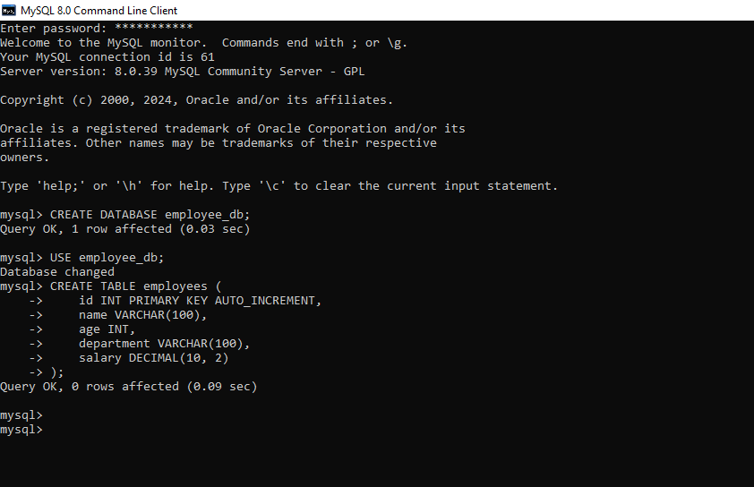
CREATING DATABASES

Slide 6
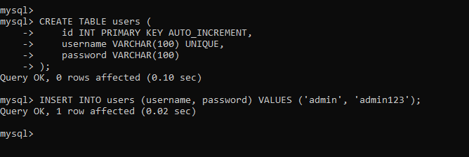
USER DATABASE

Slide 7
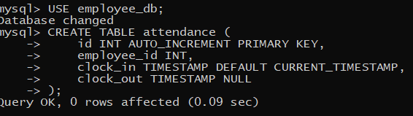
ATTENDANCE DATABASE

Slide 8
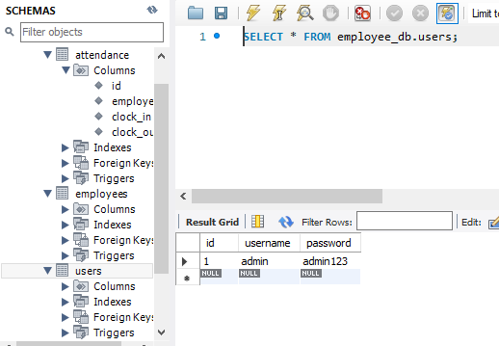
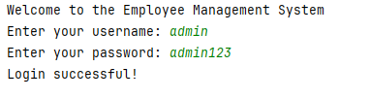
LOGIN

Slide 9
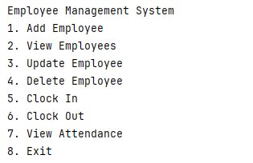
FUNCTIONALITIES

Slide 10
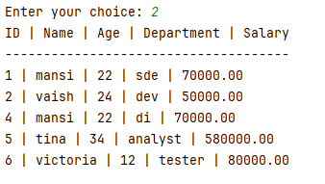
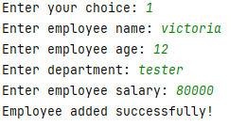
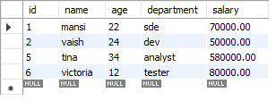



Slide 11
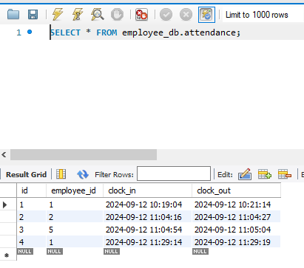
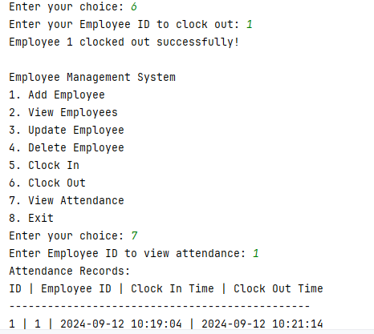
ATTENDANCE

Slide 12
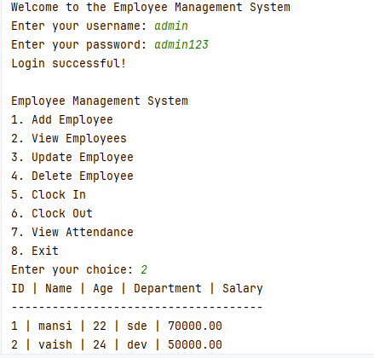
RESULTS

Slide 13
THANK YOU!

